Slide 1
Three chapters review
By Mohammed Al-Zobbi

Slide 2
Thesis Chapters-Chapter one
Title: Protecting Privacy in Big Data by Implementing Sensitivity-based Anonymity Framework
Chapter one:
Research Question
Thesis Objectives
Thesis Contribution
Thesis Layout

Slide 3
Thesis Chapters- Chapter Two
Chapter Two: Background and Challenges
Big Data: Research Challenges
Big Data analytics Challenges.
Security Challenges in Big Data Analytics.
Possible Attacks in Differential Privacy
Protecting Privacy by K-anonymity
Impairments in k-anonymity
K-Anonymity Frameworks
K-Anonymity Methods for Traditional Data
Generalization
Specialization
Critic of Traditional Data Anonymization Methods
K-Anonymity Method for Big Data
Generalization
Specialization
Critic of Big Data Anonymization Methods
Summary

Slide 4
Thesis Chapters- Chapter Three
Chapter Three: Multi-Dimensional Sensitivity-Based Anonymization Method
Requirements for Big Data Anonymization Method
Equivalency Increase
Information Gain and Security
Parallel Algorithm
Gradual Access
Multi-Dimensional Sensitivity-Based Anonymization Method Concept
Quasi Identifiers and Classes
Probability Concept and Anonymization Masking
Interval and Taxonomy Tree Masking
Suppression Masking
Grouping Data Vertically and Horizontally
Grouping Data Vertically
Grouping Data Horizontally using Q-ID Groups
Mathematical Equations to Calculate the Sensitivity Level
Sensitivity Level and Time Factor
Anonymization Operations
Taxonomy-tree masking
Discretization Masking
Summary

Slide 5
Thesis Chapters- Chapter Four
Chapter Four: implementing Sensitivity-Based Anonymization method by Hadoop Ecosystems.
Hadoop in Data Analytics
Hadoop Core
Hadoop Ecosystems
Hadoop security
Implementing Hadoop in LDAP Domain
Applying Kerberos for Hadoop Secure Mode
Deploying Sensitivity-Based Anonymization by using Hadoop Ecosystems
Pig Latin Core Structure
Anonymization by Pig Latin scripts
Comparison between Sensitivity-Based anonymization and Other Methods in Big Data
Anonymization Classification
Performance Comparison
Summary

Slide 6
Thesis Chapters- Chapter Five
Chapter Five: Framework for Sensitivity-Based Anonymization
Security Assertion Markup Language (SAML)
MDSBA and Granular Access Control
Live Data and Archived Data
MDSBA k̄ percentage and Business roles
MDSBA Three Services
Core Service
Initializer Service
Anonymizer Service
Improvement to MDSBA Security
Obvious Guess
Across Groups Unique Identifiers (AGUI)
Resolving Obvious Guess
Resolving Across Groups Unique Idintifier (AGUI)
Experimenting Data Disruption in MDSBA Framework
Summary

Slide 7
Thesis Chapters- Chapter Six
Chapter six: Towards Optimal Sensitivity-Based Anonymization for Big Data
Previous Solution to Find the Optimal k Value
MDSBA Grouping and the Gradual Access
Possible attacks against MDSBA
Finding the optimal k value
Cumulative Frequency
Linear Regression
Three security levels
Finding the Optimal k percentage
Dynamic G(QID) groups
Summary

Slide 8
Thesis Chapters- Chapter Seven
Chapter seven: Comparison between MapReduce and Spark in Processing Sensitivity-based Anonymization Framework
Analytics in Big Data
Spark Structure
MapReduce and Spark
Data Streaming Versus Batching
Implementing MDSBA in Spark
User Defined Function in MDSBA
Differences between Pig and Spark Algorithms
Comparison between Hadoop ecosystems and Spark
Spark Tuning in MDSBA
Summary

Slide 9
Thesis Chapters- Chapter Eight
Chapter 8: Conclusion
More Details

Slide 10
Chapter Three
Chapter 3 preliminarily defines the multi-dimensional sensitivity-based anonymization method (MDSBA), and then delves in the MDSBA details.
The chapter starts by proposing the requirements for big data anonymization methods, including:
Equivalency increase
Focusing on security more than information gain
Anonymization algorithms should operate in a parallel environment
Gradual access.

Slide 11
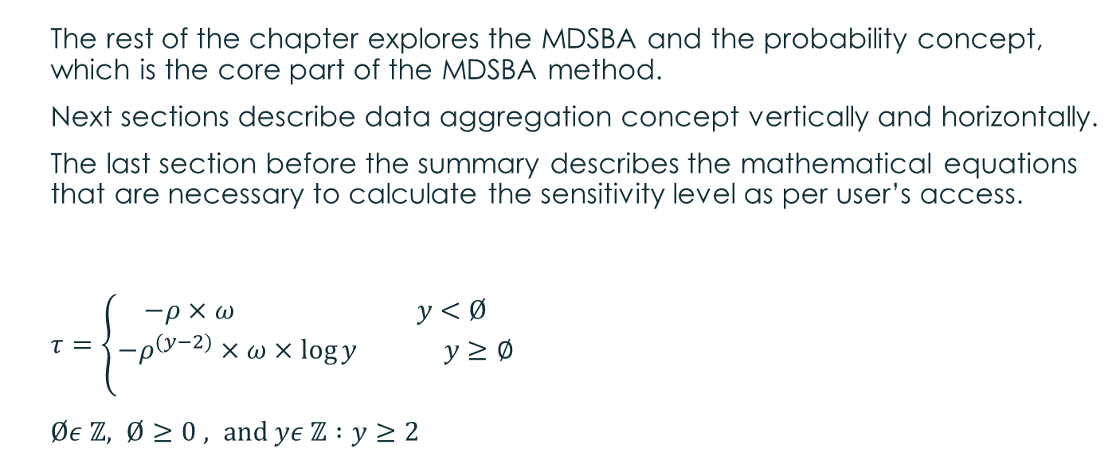
Chapter three
Both probability and aggregation are the two main components of MDSBA structure
The rest of the chapter explores the MDSBA and the probability concept, which is the core part of the MDSBA method.
Next sections describe data aggregation concept vertically and horizontally.
The last section before the summary describes the mathematical equations that are necessary to calculate the sensitivity level as per user’s access.
$τ=\left\{\begin{aligned}−ρ×ω y<Ø \\ −ρ^{(y−2)}×ω×\log{y} y≥∅ \\ \end{aligned}\right.$
$Øε ℤ, Ø≥0 , and yε ℤ :y≥2$

Slide 12
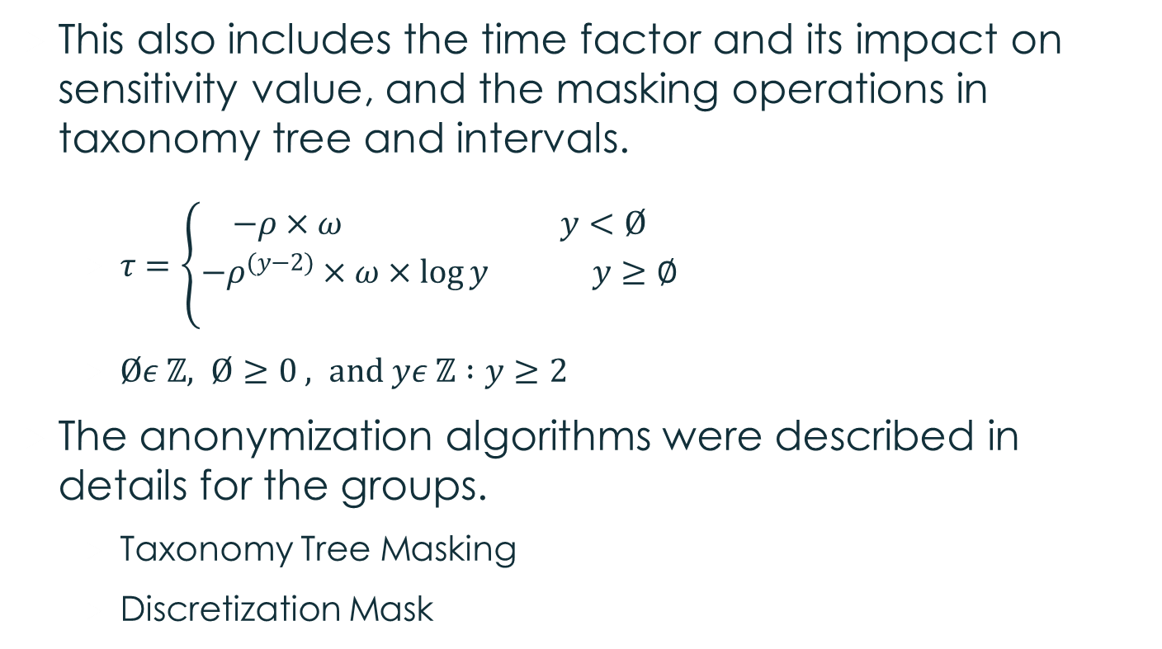
Chapter three
This also includes the time factor and its impact on sensitivity value, and the masking operations in taxonomy tree and intervals.
$τ=\left\{\begin{aligned}−ρ×ω y<Ø \\ −ρ^{(y−2)}×ω×\log{y} y≥∅ \\ \end{aligned}\right.$
$Øε ℤ, Ø≥0 , and yε ℤ :y≥2$
The anonymization algorithms were described in details for the groups.
Taxonomy Tree Masking
Discretization Mask

Slide 13
Chapter 4
Illustrates the state of the art of MDSBA framework.
The first sections illustrate MapReduce and Hadoop ecosystems.
The next section presents Hadoop security, and the best protection methods for Hadoop network domain.
Apply MDSBA algorithms by using Pig Latin scripts.
The scripts execute the anonymization by applying several masking methods on taxonomy trees and discretization.

Slide 14
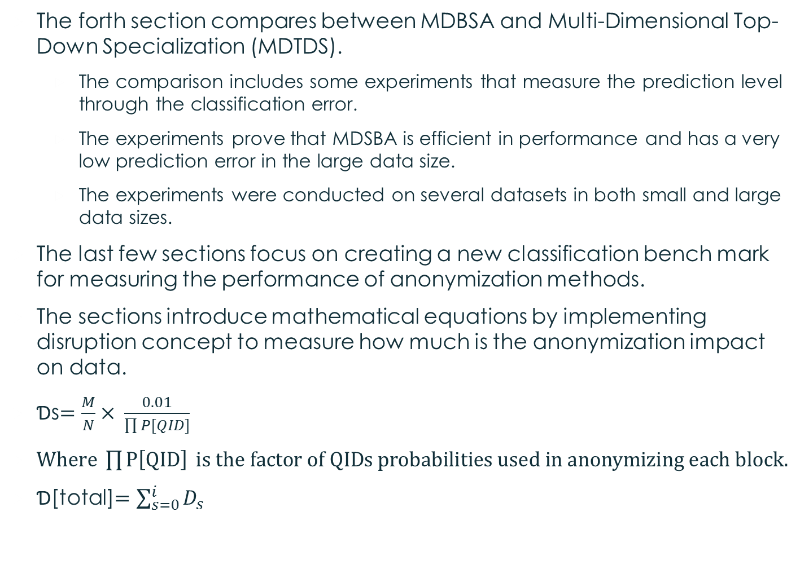
Chapter 4
The forth section compares between MDBSA and Multi-Dimensional Top-Down Specialization (MDTDS).
The comparison includes some experiments that measure the prediction level through the classification error.
The experiments prove that MDSBA is efficient in performance and has a very low prediction error in the large data size.
The experiments were conducted on several datasets in both small and large data sizes.
The last few sections focus on creating a new classification bench mark for measuring the performance of anonymization methods.
The sections introduce mathematical equations by implementing disruption concept to measure how much is the anonymization impact on data.
Ɗs$=\frac{M}{N}× \frac{0.01}{\prod{P[QID]}}$
$Where \prod{P\left[QID\right]} is the factor of QIDs probabilities used in anonymizing each block.$
Ɗ[total]$=\sum_{s=0}^{i}{D_{s}}$

Slide 15
Chapter Five
Explores the complete framework of MDSBA.
The chapter starts by describing the communication method between the Federation Service (FS) and Service Provider (SP).
The communication method is known by Security Assertion Markup Language (SAML).
The second section proposes two types of datasets, archive and live data.

Slide 16
Chapter Five
Next sections present the details of access control and business roles.
The sections describe the three services of MDSBA core. These services are distributed in FS and SP sides.
The three services include:
core, initializer, and anonymizer.
The sections conclude the method of generating the Pig Latin script.
The second part of the chapter discusses two problematic concerns in MDSBA;
Obvious Guess
The solutions for Obvious Guess is established by creating a zero filtration stage before anonymization
Across Group Unique Identifiers (AGUI).
The solution for AGUI is established by increasing the value of k. The last section before the summary explains some experiments that measure the impact of the disruption values on AGUI.

